Slide 1
Calendar Reminder 1.0
Mini App to Remind

Slide 2
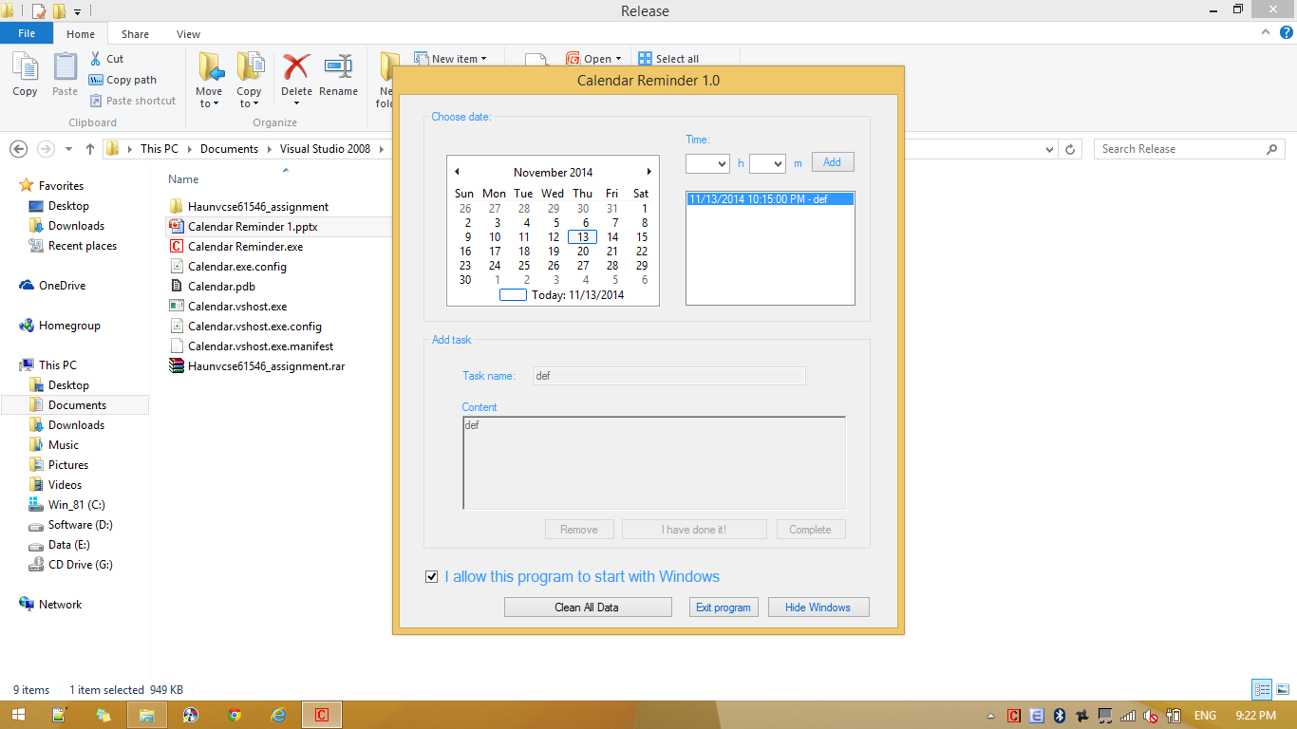
Content
Introduction
Tutorial
Where to get update

Slide 3
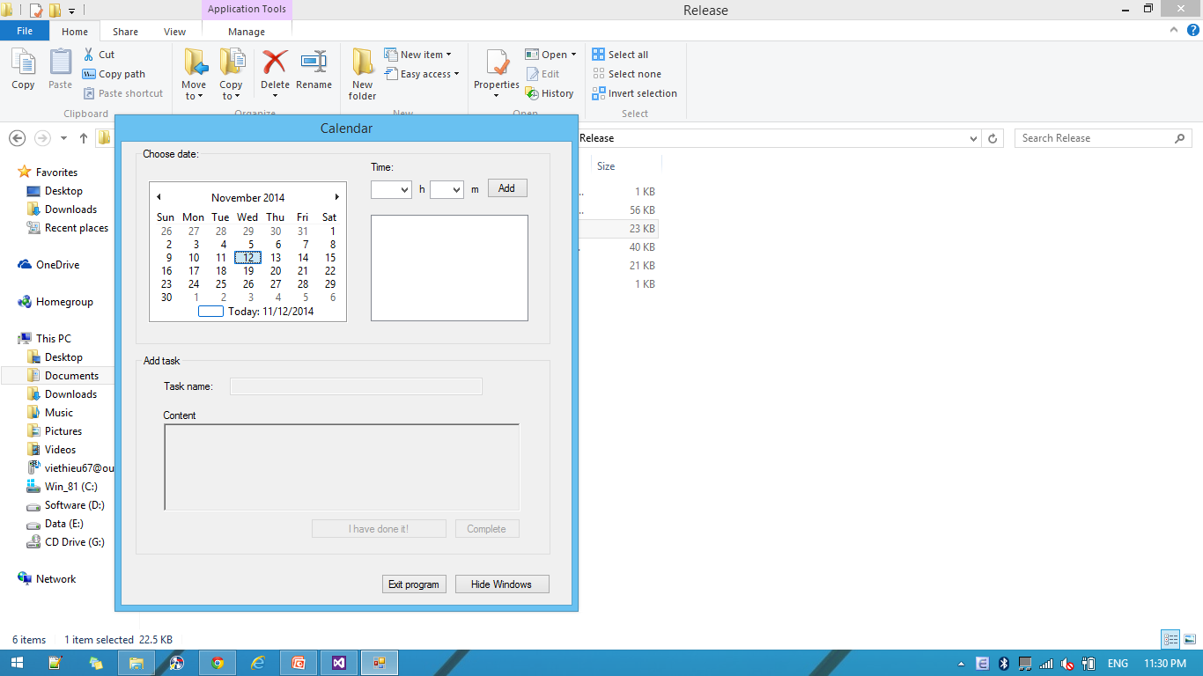
Introduction
This is a mini app to remind you when you work long time with your computer.
System requirement:
Windows 7/8/8.1
.Net Framwork 3.5
Or latest version

Slide 4
Tutorial
Step 1: Run the app “Calendar Reminder.exe”
Step 2: Choose the date with the calendar at the left of the app’s windows

Slide 5
Tutorial
Step 3: choose the hour and min to remind yourself, then click “Add”

Slide 6
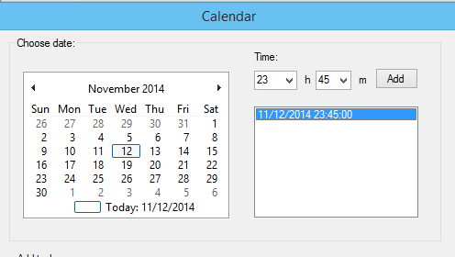
Tutorial
Step 4: If your date time is valid, you can see the new time in the box below:

Slide 7

Tutorial
Step 5: Click to the time you have just added, at the group “Add task” of the Windows, give information to the app:

Slide 8
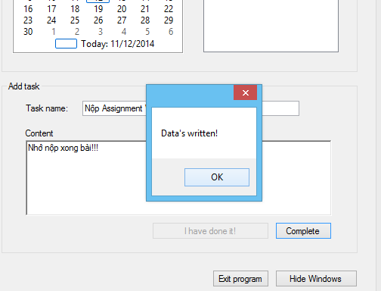
Tutorial
Step 5: Then click Complete

Slide 9
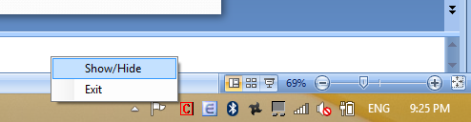
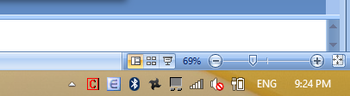
Tutorial
You can wait to the app remind you to do you task. Or you can click the button “Hide Windows” (at the bottom of the app window) to hide the app’s Windows.
You can see the app at the Notification Tray.
You can click right to the “C” icon and choose “Show/Hide” to see the window again.

Slide 10
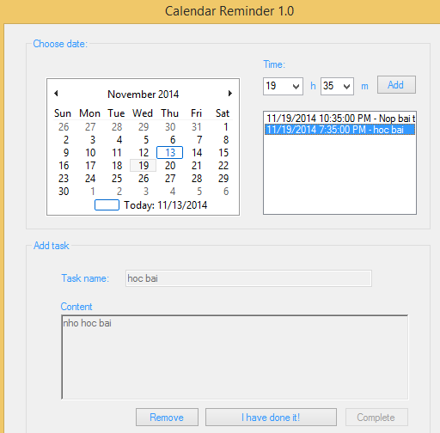
Tutorial
You can also use the calendar of the app to review all your task:
Step 1: choose t he date at the group “Choose date” of the app window.
Step 2: choose the time at the box of the Calendar.
Step 3: View your tasks at group “Add task”;
If you want to delete a task, click “Remove” when you view a task.

Slide 11
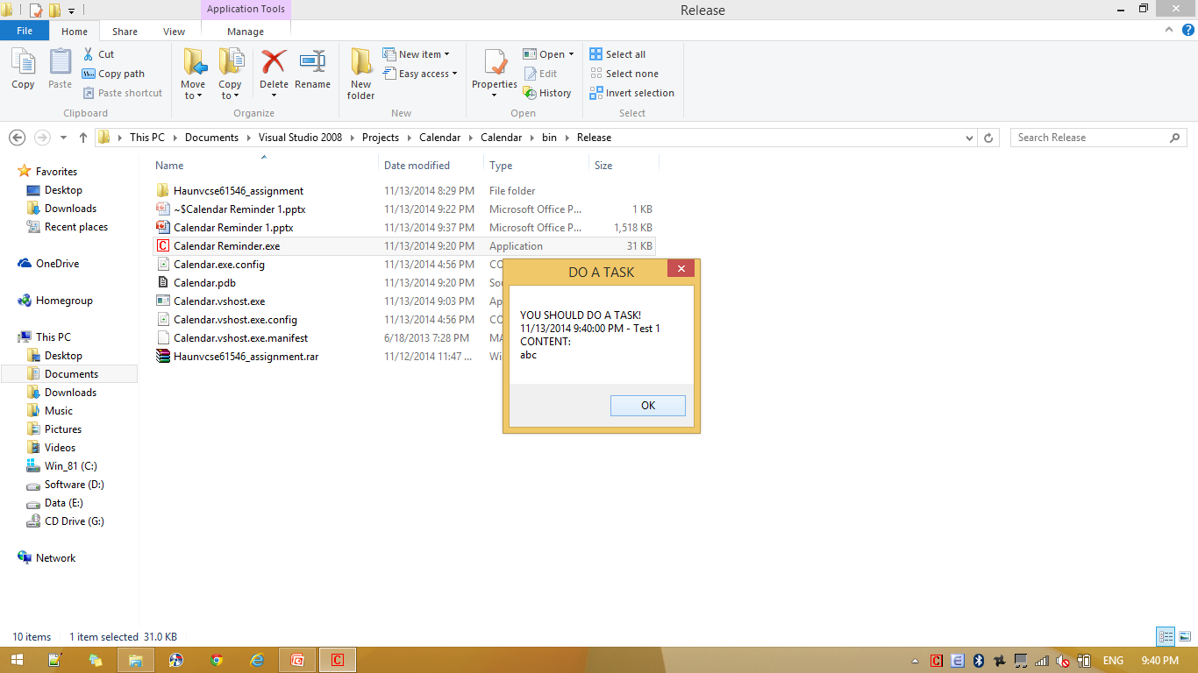
Tutorial
When a task’s time’s coming, the app will show this message 5 times:

Slide 12
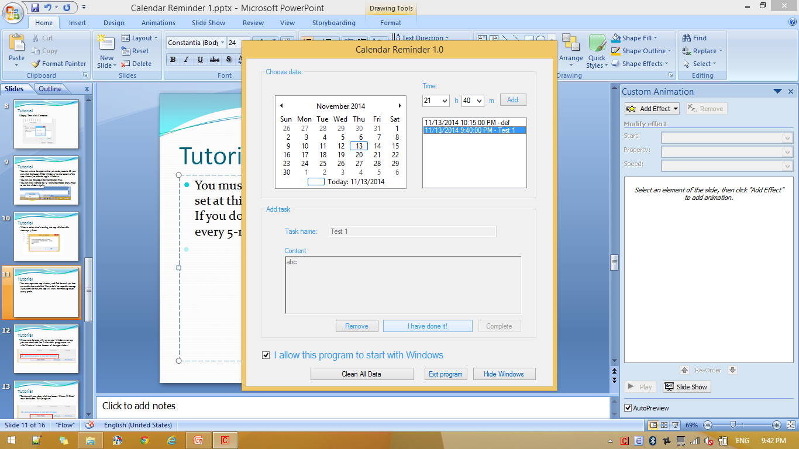
Tutorial
You must open the app window, and find the task you have set at this time and click “I have do it!” to stop this message. If you don’t do that, the app will show the message to you every 5-min.

Slide 13
Tutorial
If you want the app will run at your Windows startup, you can check the line “I allow this program to run with Windows” at the bottom of the app window.

Slide 14
Tutorial
To clean all your data, click the button “Clean All Data” near the button “Exit program”.

Slide 15
Where to get update
Because it is just a demo version, it may get many bugs.
The latest version will be updated on my blog:
http://nvconghau.wordpress.com/

Slide 16
Thank for your watching

